Slide 1
CS 331
Topic: The Standard Template Library Part 1
MD Romael Haque

Slide 2
Introduction to the Standard Template Library
The Standard Template Library is an extensive collection of templates for useful data structures and algorithms.
In addition to its runtime library, which you have used throughout this book, C++ also provides an extensive library of templates.
The Standard Template Library (or STL) contains numerous templates for classes and functions.

Slide 3
STL Container and Iterator Fundamentals
A container is an object that holds a collection of values or other objects.
An iterator is an object that is used to iterate over the items in a collection, providing access to them.

Slide 4
Containers
There are two types of container classes in the STL: sequence and associative.
A sequence container stores values by position or index: the first item stored is placed at index 0 in the container, the second is stored at index 1, the third at index 2, and so on.
Sequence containers are in many ways similar to arrays, and in fact, some of them internally use an array to store their values.
A value stored in a sequence container is accessed through its assigned index.
Sequence containers allow duplicate values to be stored at different indices within the container.

Slide 5
Containers
In contrast, associative containers do not store their elements by an integer-based position.
Instead, a value to be stored is associated with another value called its key, and the value is stored and accessed through its associated key.
You can think of the key as playing the role of the index in a sequence container.

Slide 6
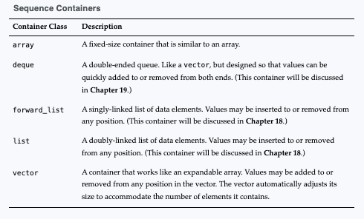
Containers

Slide 7
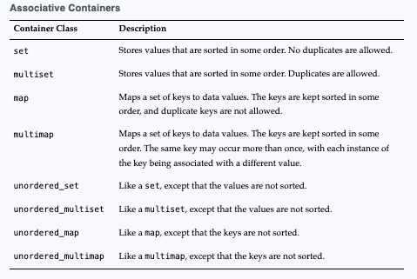
Containers

Slide 8
Containers
In addition to the classes listed in previous tables, the STL also provides the three container adapter classes named stack, queue, and priority queue (Future self-study for you).
A container adapter class is not itself a container, but a class that adapts one of the other containers to a specific use.
You can think of an adapter as a sort of "container" that delegates the storage of its elements to another container.

Slide 9
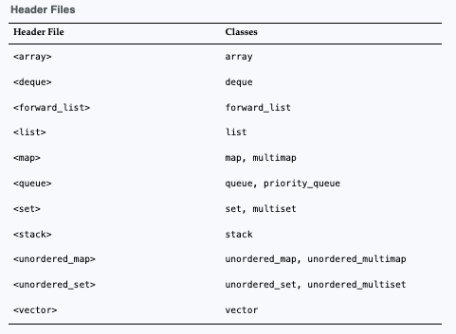
Containers
The container and container adapter classes are declared in various STL header files.
This table lists the necessary header files that you will need to include, depending on the containers that you intend to use.

Slide 10
Introduction to the array Class
Perhaps the simplest container in the STL is the array class, which was introduced in C++ 11.
An array object works very much like a regular array.
It is a fixed-size container that holds elements of the same data type.
In fact, an array object uses a traditional array, internally, to store its elements.
An advantage that array objects have over regular arrays is that array objects have a size() member function that returns the number of elements contained in the object.

Slide 11
Introduction to the array Class
When you define an array object, you must specify the data type of its elements and the number of elements the object will store.
Here is an example: array<int, 5> numbers;
This statement defines an array object named numbers.
Inside the angled brackets <>, the data type int is the type of each element, and the value 5 is the number of elements the object will have.
You can provide an initialization list to initialize an array, as shown here: array<int, 5> numbers = {1, 2, 3, 4, 5};

Slide 12
Introduction to the array Class
Here is an example of defining an array to hold four strings:
array<string, 4> names = {"Jamie", "Ashley", "Doug", "Claire"};
The array class overloads the [] operator, giving you the ability to access elements using an index, just as you would with a regular array

Slide 13
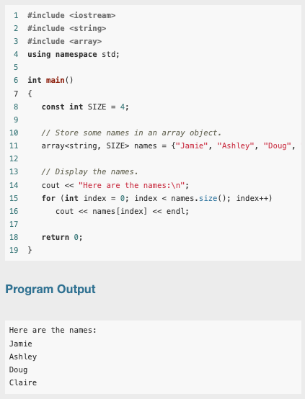
Introduction to the array Class
The statement in line 11 defines an array object named names, initialized with four strings.
The for loop in lines 15 through 16 displays all of the strings.
Notice that the array object's size() member function is used in the loop's test expression.
In line 16, the [] operator is used to access the object's elements.

Slide 14
Introduction to the array Class
As you can see, the array class is an object-oriented alternative to a traditional array in C++.
The array class also provides several member functions that give additional capabilities.

Slide 15
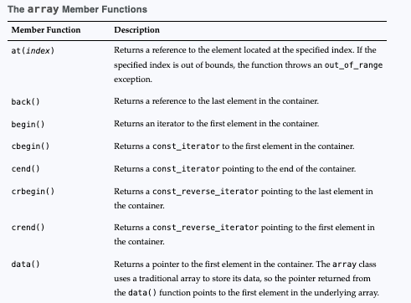
Introduction to the array Class

Slide 16
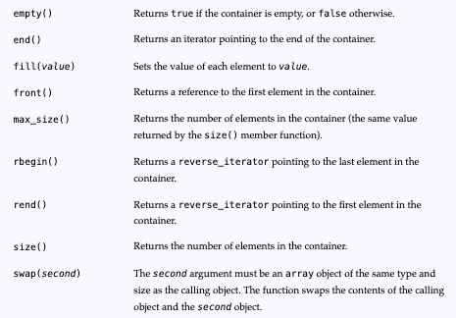
Introduction to the array Class

Slide 17
Iterators
Iterators are objects that work like pointers, and are used to access data stored in containers.
As the name implies, you can use an iterator to iterate over the contents of a container.
There are currently five categories of iterators

Slide 18
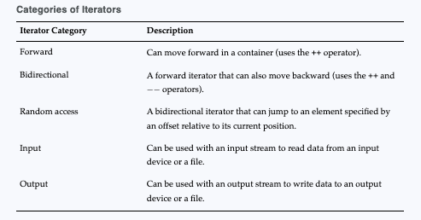
Iterators

Slide 19
Iterators
Iterators are associated with containers.
The type of container you have determines the category of iterator you use. For example:
The array, vector, and deque containers use random-access iterators
The list, set, multiset, map, and multimap containers use bidirectional iterators
The forward_list, unordered_map, unordered_multimap, unordered_set, and unordered_multiset containers use forward iterators

Slide 20
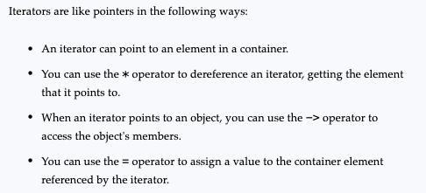
Iterators

Slide 21
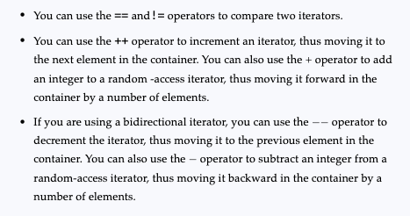
Iterators

Slide 22
Defining an Iterator
Before you can define an iterator, you have to know the type of container that you want to use the iterator with.
The general format of an iterator definition is:
containerType::iterator iteratorName;
In the general format, containerType is the STL container type, and iteratorName is the name of the iterator variable that you are defining.

Slide 23
Defining an Iterator
For example, suppose we have defined an array object as follows:
array<string, 3> names = {"Sarah", "William", "Alfredo"};
We can define an iterator that will work with the array object with the following statement:
array<string, 3>::iterator it;
This statement defines an iterator named it that can be used with an array<string, 3> object.
The compiler automatically chooses the right type of iterator (in this case, a random-access iterator).

Slide 24
Getting an Iterator from a Container Object
All of the container classes in the STL provide a begin() member function and an end() member function.
The begin()member function is straightforward: it returns an iterator pointing to the first element in a container.

Slide 25
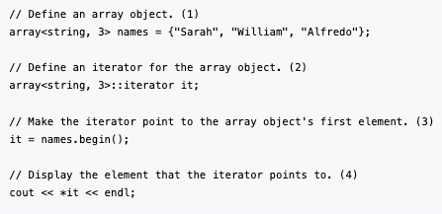
Getting an Iterator from a Container Object
(1) It defines an array object initialized with three strings.
(2) It defines an iterator that can be used with the array object.

Slide 26
Getting an Iterator from a Container Object
(3) It makes the iterator point to the first element in the array object.
(4) It uses the * operator to dereference the iterator, and displays the element that the iterator points to.

Slide 27
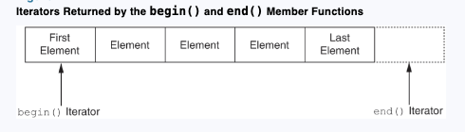
Getting an Iterator from a Container Object
The end() member function returns an iterator pointing to the position after the last element.
This means it returns an iterator that does not point to an element, but points to the end of the container.

Slide 28
Getting an Iterator from a Container Object
The end() member function returns an iterator pointing to the position after the last element.
This means it returns an iterator that does not point to an element, but points to the end of the container.
You typically use the end() member function to know when you have reached the end of a container in algorithms that iterate over a range of elements

Slide 29
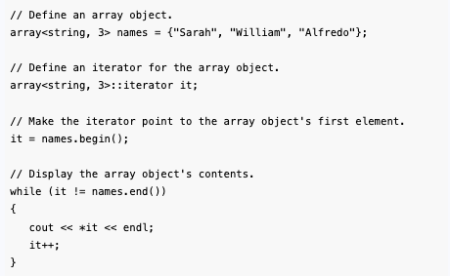
Getting an Iterator from a Container Object

Slide 30
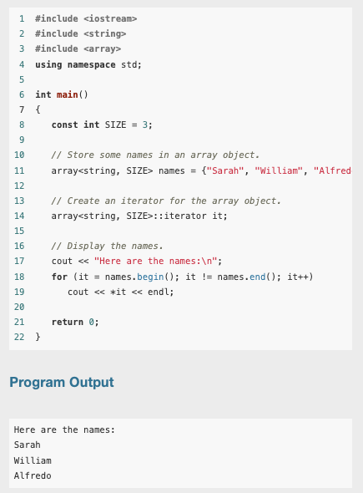
Getting an Iterator from a Container Object
The code previously shown could be shortened somewhat by using a for loop instead of a while loop.

Slide 31
Using auto to Define an Iterator
Quite often, you can use auto to simplify the definition of an iterator.
For example, any time that you are initializing an iterator with the value that is returned from a member function such as begin(), you can use auto in the iterator's declaration.

Slide 32
Using auto to Define an Iterator
For example, look at the following code:
array<string, 3> names = {"Sarah", "William", "Alfredo"}; array<string, 3>::iterator it = names.begin();
The second statement defines an iterator named it and calls the names.begin() member function to initialize it.
This statement can be rewritten as shown in the following code:
array<string, 3> names = {"Sarah", "William", "Alfredo"}; auto it = names.begin();

Slide 33
Using auto to Define an Iterator
The auto declaration shown in the second statement works because the names.begin() function returns an object of the array<string, 3>::iterator type.
So, the compiler can determine that it should be an object of the array<string, 3>::iterator type.
This is especially useful in for loops that use iterators to step through the elements of a container.
Let’s look at an example

Slide 34
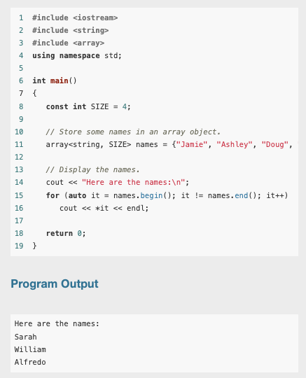
Using auto to Define an Iterator

Slide 35
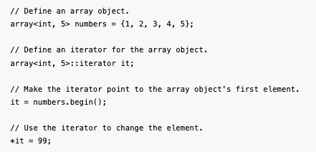
Mutable Iterators and const_iterators
An iterator of the iterator type gives you read/write access to the element that the iterator points to. This is commonly known as a mutable iterator. The following code snippet shows an example:

Slide 36
Mutable Iterators and const_iterators
In the code snippet, the numbers object initially contains the values 1, 2, 3, 4, and 5.
The last statement dereferences the it iterator (which points to the first element) and changes the element's value to 99.
After the last statement executes, the numbers object contains the values 99, 2, 3, 4, and 5.

Slide 37
Mutable Iterators and const_iterators
If you want to make sure that nothing changes the contents of a container, you can use the const modifier with the container definition to make the container's contents constant.
Here is an example:
const array<string, 3> names = {"Sarah", "William", "Alfredo"};
This statement defines names as a const array object.
As a result, the elements in the container are constant, and cannot be modified.
Attempting to modify the container's contents will result in an error at compile-time.

Slide 38
Mutable Iterators and const_iterators
If we need an iterator to work with the object, we must use a const_iterator, which provides read-only access to any element that it points to.
The following statement shows an example of how to define a const_iterator:
array<string, 3>::const_iterator it;

Slide 39
Mutable Iterators and const_iterators
All of the container classes in the STL provide a cbegin() member function and a cend() member function.
The cbegin() member function returns a const_iterator pointing to the first element in a container.
The cend() member function returns a const_iterator pointing to the end of the container.
When working with const_iterators, simply use the container class's cbegin() and cend() member functions instead of the begin() and end() member functions.

Slide 40
Reverse Iterators
A reverse iterator is a bidirectional or random-access iterator that works in reverse, allowing you to iterate backwards over the elements in a container.
When using a reverse iterator, the last element in a container is considered the first element, and the first element is considered the last element.
The ++ operator moves a reverse iterator backward, and the -- operator moves a reverse iterator forward.

Slide 41
Reverse Iterators
These STL containers support the use of reverse iterators: array, deque, list, map, multimap, multiset, set, and vector.
All of these classes provide an rbegin() member function and an rend() member function.

Slide 42
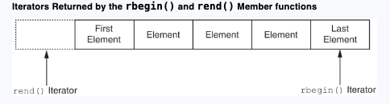
Reverse Iterators
The rbegin()member function returns a reverse iterator pointing to the last element in a container, and the rend()member function returns an iterator pointing to the position before the first element.

Slide 43
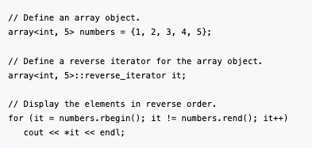
Reverse Iterators
To create a reverse iterator, you define it as reverse_iterator.

Slide 44
Reverse Iterators
Iterators that are declared as reverse_iterator are mutable, meaning that they give you read/write access to the element being pointed to.
If you need a reverse iterator to work with a const container, you must use a const_reverse_iterator, which provides read-only access to any element that it points to.
The following code shows an example of how to create a const_reverse_iterator:
const array<string, 3> names = {"Sarah", "William", "Alfredo"}; array<string, 3>::const_reverse_iterator it;

Slide 45
Reverse Iterators
Each of the STL container classes that support reverse iterators provide a crbegin() member function and a crend() member function.
The crbegin() member function returns a const_reverse_iterator pointing to the last element in the container.
The crend() member function returns a const_reverse_iterator pointing to the position before the first element in the container.

